Slide 1
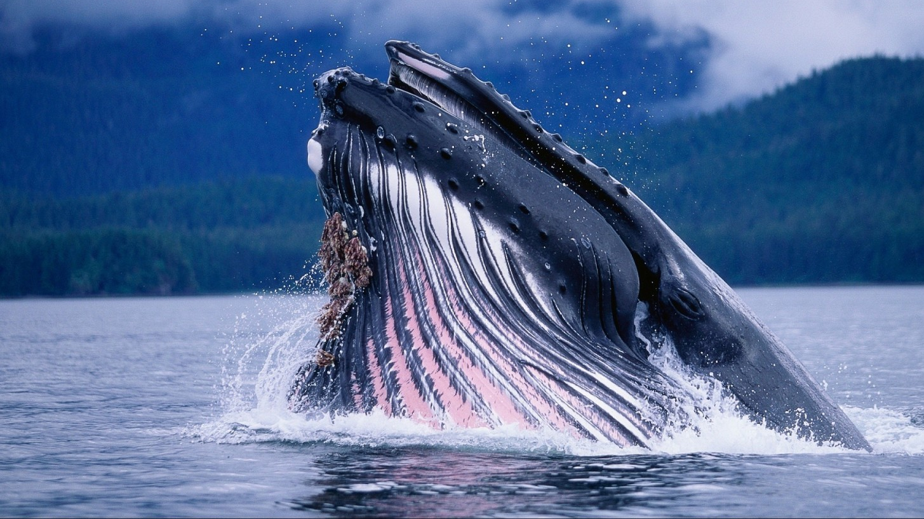
Identifying a Whale by it’s Tail
Comparison of various image classification methods

Slide 2
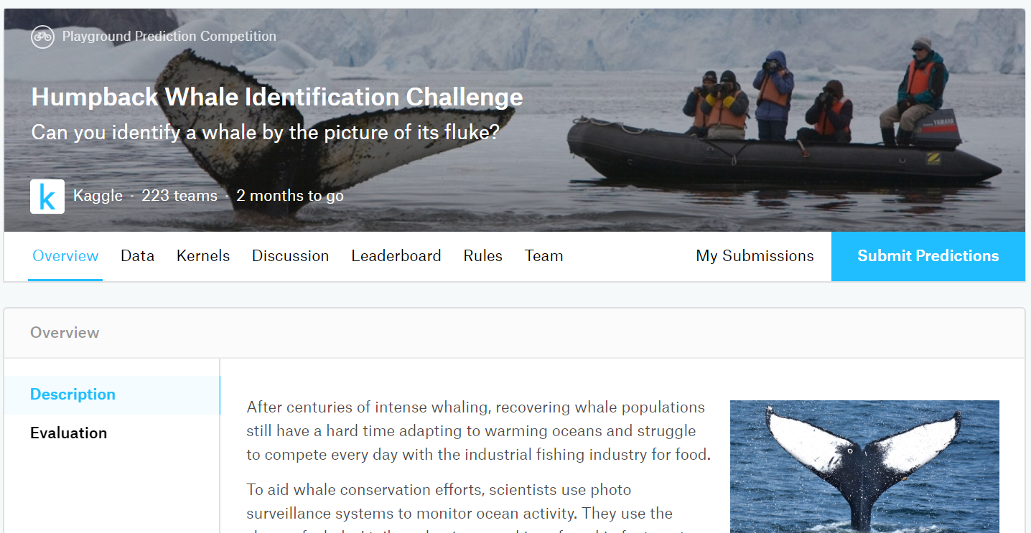
About the Dataset
From Kaggle competition
9000+ images
1900+ Groups

Slide 3
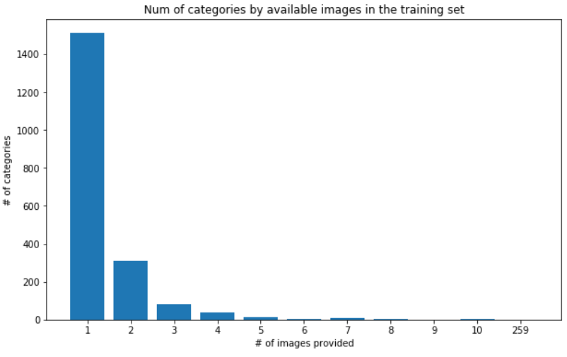
Problems
The dataset includes a catch-all category called “new whale” which includes the vast majority of the images
Technically speaking, you could just classify all images as new whale and be correct roughly 8% of the time
A lot of classes contained only 1 image

Slide 4
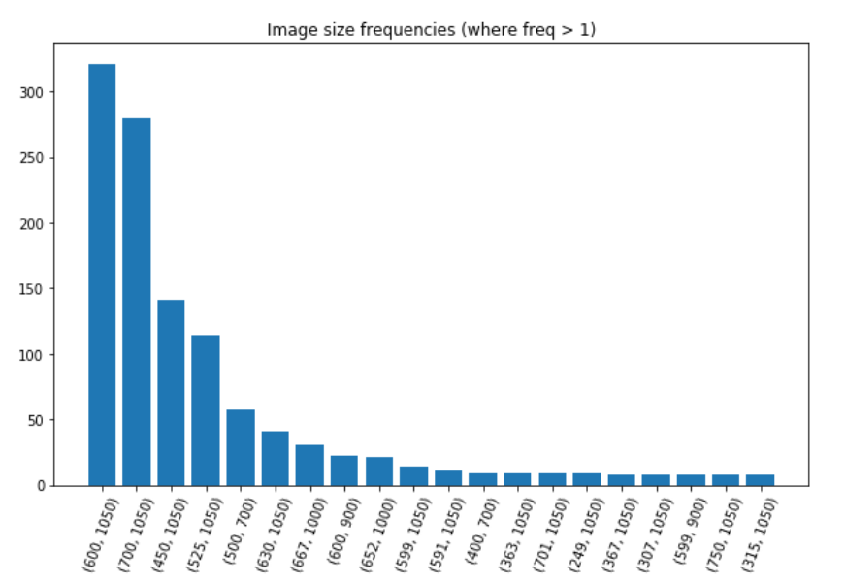
More Problems
Images varied greatly in size from 1050x1574 to 64x30
Needed to somehow standardize size

Slide 5
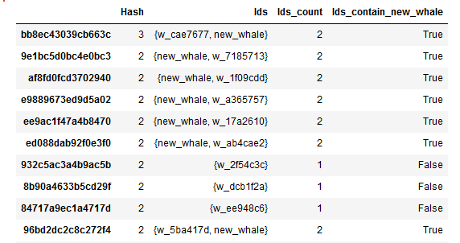
Even More Problems
Quite a few of the images were duplicated and placed either:
under the same label
Placed under several labels
placed under “new whale” in addition to other labels
Found by translating images into hashes and grouping

Slide 6


Solutions for Data Preparation
Removed the new whale category entirely
Removed category's with < 10 images
Removed duplicates from remainder
Result was 48 classes which we padded with augmented data (over 2,000 images)

Slide 7
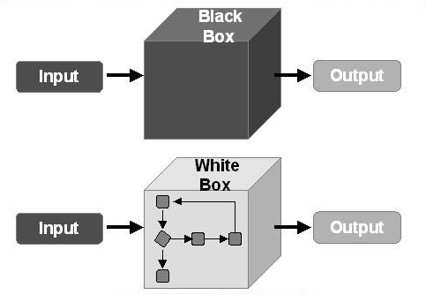
Classification Methods
White Box Classification
SVM, KNN, Decision Tree, etc.
Needs feature extraction
Needs more data processing
More easy to be implemented
Black Box
Deep Neural Network
No manual data extraction
Multiple feature methods applied automatically
Extremely resource intensive

Slide 8
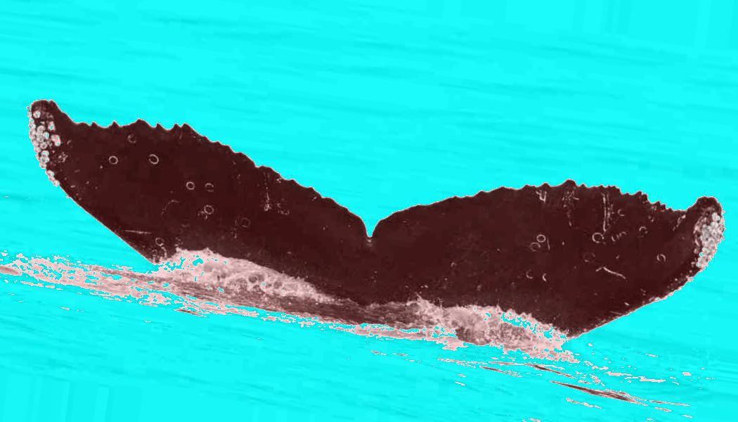
Data Augmentation
Set to high contrast and then applied greyscale
Applied random rotations and shifts to create additional data
Found a mean size then resized to 100 x 100 while maintaining aspect ratio
Filled remaining area with random noise based on nearest cells

Slide 9
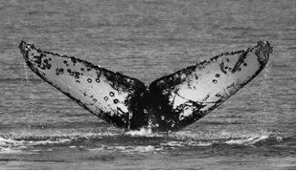

L2-Histogram of Gradients (HOG)
HOG convolves the images with two filters that are sensitive to horizontal and vertical brightness gradients--allowing us to capture
Edge
Contour
Texture information
HOG also subdivides the images into cells of a predetermined size, and computes histograms of the gradient orientations within each cell.
Data is normalized in each cell and the result is a one dimensional feature vector made from the information in each cell of an image.
Numpy array of (2256, 8100)

Slide 10
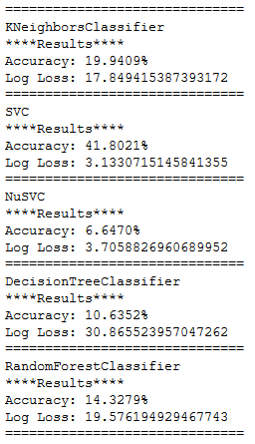
White Box Classifiers
We started by implementing 5 basic classifiers without parameter tuning
K Nearest Neighbors
SVC (C-Support SVM). C is penalty value
NuSVC: similar to SVC but uses a parameter to control the number of support vectors
Decision Tree
Random Forest (messed up… supposed to use with decision tree)

Slide 11
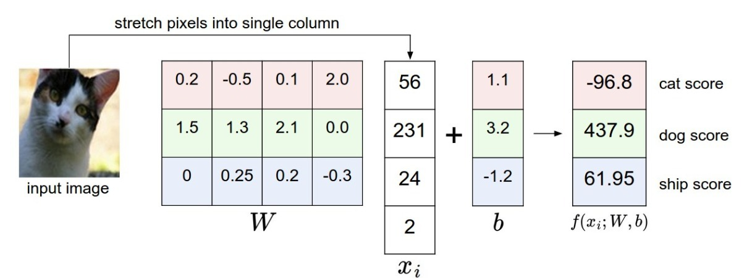
Parameter Tuning of SVM
SVM:
Tried both rbf and linear through Grid Search
Best Para: C = 100, linear kernel
Linear kernel: the images are stretched into high-dimensional column (8100), each image is a single point in this space. Linear Classifiers computes the score of a class as a weighted sum of all of its pixels values across the column.

Slide 12
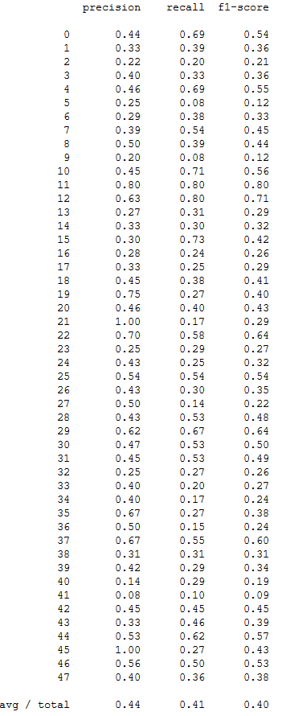
Result of SVM
F1-Score avg 0.40
Precision avg 0.44
Recall avg 0.41
For 48 classes using a linear kernel it’s not horrible but not good

Slide 13

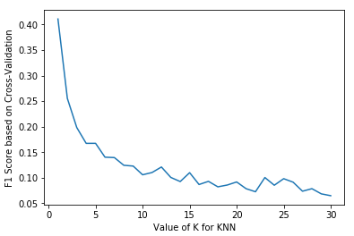


Parameter Tuning of KNN

Slide 14
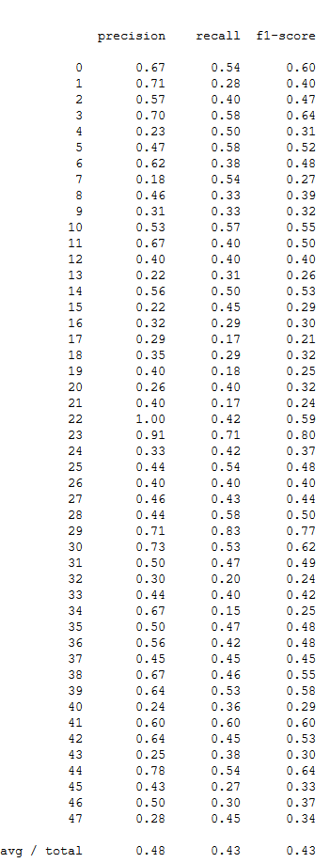
KNN Tuning Results
F1-Score avg 0.43
Precision avg 0.48
Recall avg 0.43
Better…

Slide 15
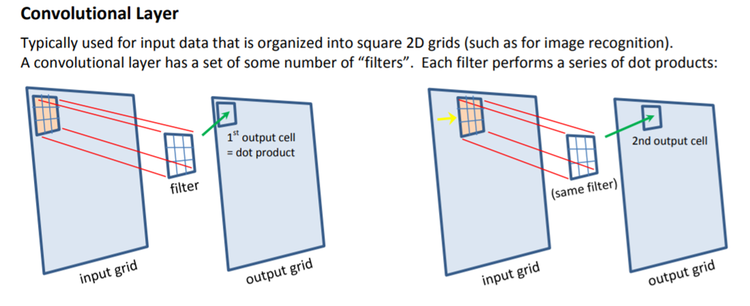
Convolutional Neural Network

Slide 16
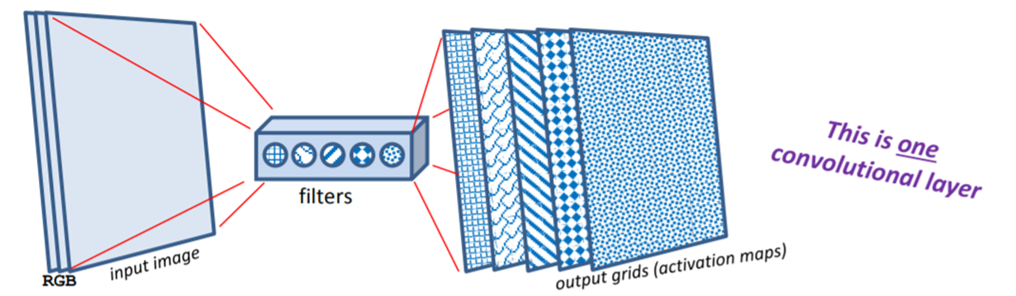
CNN
Each filter extract one feature
Early stage detect low level features
Train on themselves

Slide 17
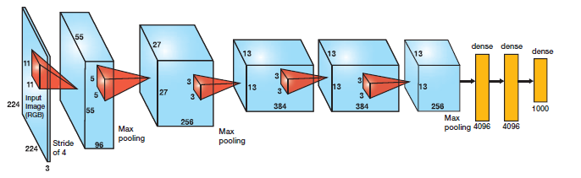
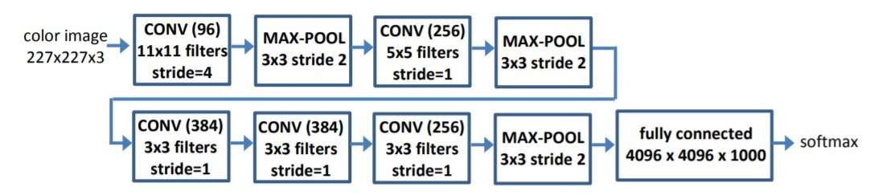

Slide 18
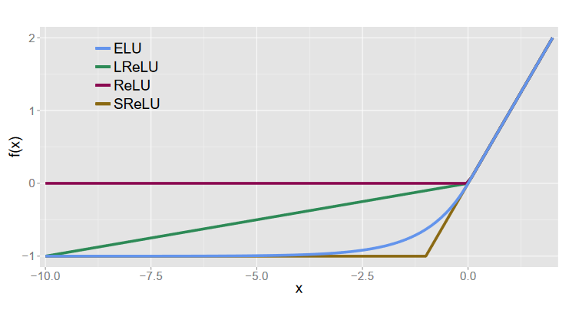
Modifications
Based on paper: https://arxiv.org/pdf/1511.07289.pdf
Use Exponential Linear Units instead of Rectified ELU (RELU)
Add extra Layer
Supposedly good for smaller datasets

Slide 19
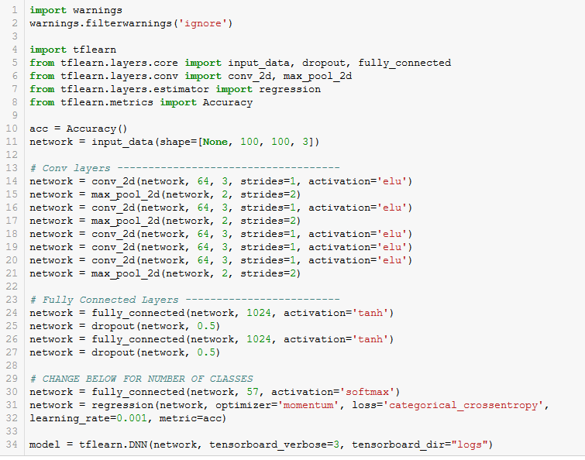

Slide 20
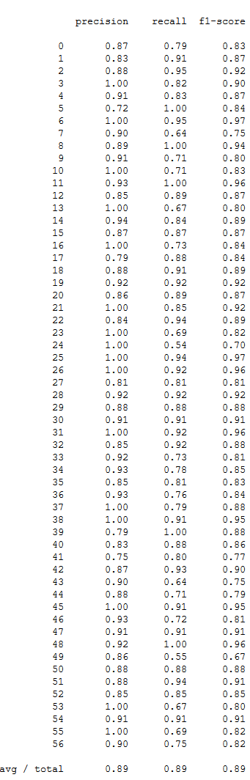
Results
2 hours to run on a Nvidia 1050ti
F1-Score avg 0.89
Precision avg 0.89
Recall avg 0.89

Slide 21
Conclusions
CNN Provide best results for image classification on this scale
SVM and KNN apply a SoftMax and are essentially just one layer of CNN
CNN takes a very long time even with GPU
CNN doesn’t reveal features extracted, however more are extracted
BE CONSISTENT WITH LIBRARIES
If doing images, don’t do what we did. Just do CNN and maybe apply SVM at the end to improve performance

